Slide 1
Introduction to Apache Spark and RDD

Slide 2
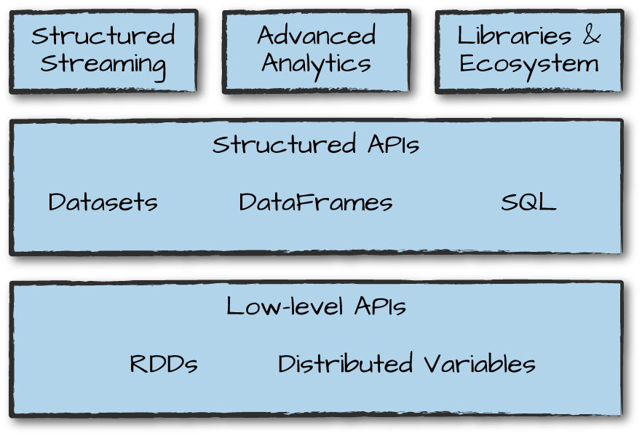
Lesson Objective and Overview
The "Introduction to Apache Spark and RDD" presentation provides a comprehensive introduction to Apache Spark, an open-source distributed computing system. It covers essential concepts, architecture, components, and practical implementations of Spark, focusing on Resilient Distributed Datasets. and how to set up Spark on a local computer and run a basic Spark application.
If you want to build a career in Data Engineering, Big Data, or AI, learning Apache Spark and PySpark is a must-have skill! It enables you to handle real-world data challenges efficiently and opens doors to exciting career opportunities.
img src: .oreilly.com

Slide 3
By the end of this lesson, learners will be able to,
Define Spark Ecosystem and Framework
Describe the Spark Architecture
Setup Spark on local computer
Describe Spark RDD
Utilize Spark RDD
Implement RDD Transformations and Actions to process large-scale data efficiently.
Work with real datasets and apply Spark operations for data analysis.

Slide 4
Table of contents
Introduction to Apache Spark
Benefits of Apache Spark
Spark Ecosystem / Framework / Libraries
Overview of Spark Core
Overview of Spark Architecture
Spark Deployment Modes
Overview of PySpark?
Key Features of PySpark
How does PySpark work?
Downloading Spark
Spark-submit command
Initializing Spark Application
Do We Use SparkSession or SparkContext in PySpark?
Overview to Spark RDD
How to Create RDD
Parallelized Collections -RDD
External Data Sets - RDD
Passing Functions in Spark
Introduction to RDD Operations
Overview to RDD Transformations
Overview to RDD Actions

Slide 5
Sample Data Set Resources
In this module, we will use the datasets below for demonstrations.
Click here to Download “airport.txt”
Click here to Download “adult_data.csv”
Click here to Download “word_count.txt”
Click here to Download “Car.csv”
Click here to Download “cardataOne.txt”
Click here to Download “cardataTwo.txt”
Click here to Download “RealEstate.csv”
Click here to Download “multiline_zipcode”

Slide 6
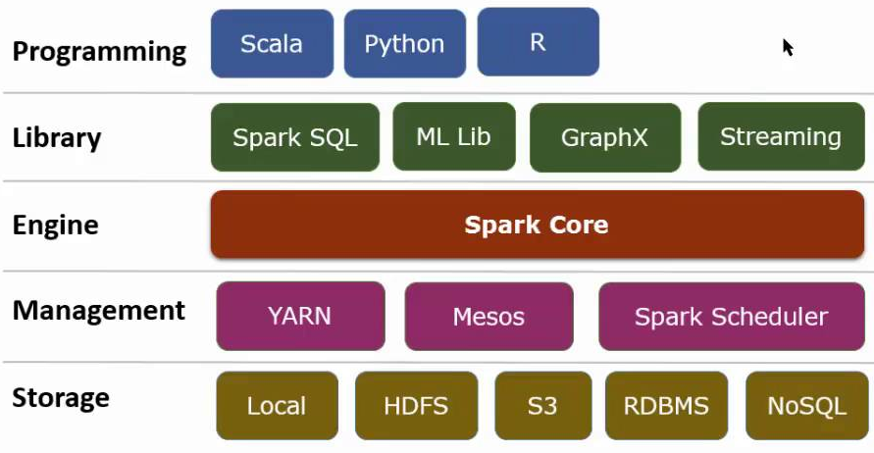
Introduction to Apache Spark
Since 2009, the Apache Software Foundation has hosted Apache Spark, with over 1,000 contributions from over 250 organizations:

Slide 7
Introduction to Apache Spark
Apache SparkTM is a multi-language engine for data engineering, data science, and machine learning. Apache Spark follows a master/worker node architecture, with one master or driver process and more than one worker process.
An efficient engine supports broad execution graphs and high-level APIs in Java, Scala, Python and R, and supports code reuse across multiple workloads (batch processing, interactive queries, real-time analytics, machine learning, and graph processing).
Spark is good for in-memory caching processing and improved query execution for rapid data analytics queries.
The driver program runs the user's main function and performs numerous parallel operations on a cluster.
Spark's core abstraction is a Resilient Distributed Dataset (RDD), which is a collection of objects partitioned across the cluster's nodes.
Spark does not execute the tasks immediately but maintains a chain of operations as metadata of the job — Directed Acyclic Graph [DAG]. The action on the DAG happens only when an action operation is called onto the transformation DAG. This process is referred to as lazy evaluation.

Slide 8
Benefits of Apache Spark
Apache Spark is highly regarded for its performance and features. Here are some key benefits:
Free and Open Source: Spark is free to use with publicly available source code.
Performance: It offers low latency and fast processing, reusing data to reduce computational demands.
Scalability: Spark can scale to thousands of nodes and handle petabytes of data.
Memory Management: It stores data in memory for speed but can also use disk storage for large datasets.
Cluster Support: Optimized for clusters, Spark can run on Hadoop YARN or locally with parallel threads.
Ease of Use: Simple APIs and high-level operators make it easy to build and deploy applications.

Slide 9
Benefits of Apache Spark (continued)
Code Reuse: Modular design allows routines to be reused across different programs.
Language Support: APIs for Java, Scala, Python, and R without needing extra libraries.
Advanced Tools: Spark includes the following built-in tools:
Spark SQL for queries.
MLlib for machine learning.
GraphX for graph processing.
Structured Streaming to incrementally process streams.
Batched Processing: Spark can break data into branches for more efficient processing. It integrates data parallelism into its data structures. Developers can create a job to run on parallel systems without worrying about dispatching tasks or resource management. The Spark Engine handles scheduling and task distribution.

Slide 10
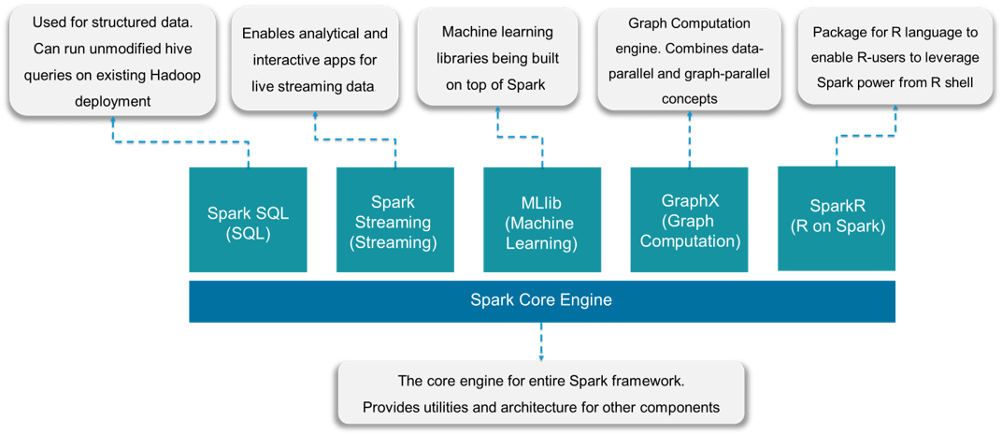
Spark Ecosystem / Framework / Libraries
Spark Ecosystem comprises the following components:

Slide 11
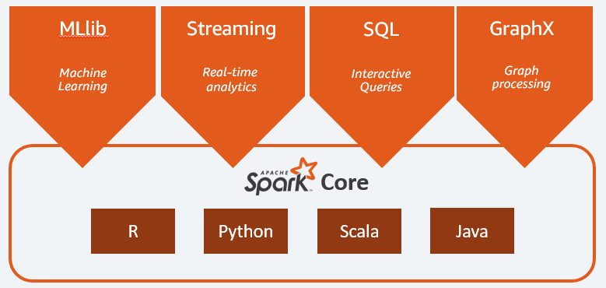
Spark Ecosystem / Framework / Libraries (continued)
The Apache Spark framework includes:
Apache Spark Core as a foundation for the platform.
Spark MLlib for machine learning.
Spark Streaming for real-time analytics.
Spark SQL for interactive queries.
Spark GraphX for graph processing.
Apache Spark Core
Source: spark.apache.org

Slide 12
Overview of Spark Core
Spark Core is the heart of the Apache Spark framework. It is the base engine for large-scale parallel and distributed data processing and uses a very special data structure — RDD.
SparkCore performs various important functions such as memory management, job monitoring, fault tolerance, job scheduling, and interactions with storage systems. Further, additional libraries, built atop the core, allow diverse workloads for streaming, SQL, and machine learning. It is responsible for:
Performing memory management and fault recovery.
Interacting with storage systems.
Performing all the basic I/O functions, scheduling, and monitoring jobs on cluster, etc. Also, fault recovery and effective memory management are Spark Core’s other important functions.

Slide 13
Core Components of Spark Core
📌 RDD (Resilient Distributed Dataset) – Immutable, distributed collection of objects that enables parallel processing. 📌 DAG (Directed Acyclic Graph) Execution – Optimizes job execution using a dependency graph. 📌 Task Scheduler – Manages job execution and parallel task distribution. 📌 Memory Management – Efficiently uses in-memory caching for performance improvement. 📌 Fault Recovery Mechanism – Recomputes lost data using RDD lineage. 📌 API Support – Provides high-level APIs in Python, Scala, Java, and R.

Slide 14
Overview of Spark Architecture
Spark uses master/worker architecture, one master node, and many worker nodes. Here, the driver is the central coordinator. The Driver program runs in its own Java process. These drivers handle a large number of distributed workers. These distributed workers are actually executors. Each executor works as a separate Java process. The Spark application is a collaboration of the driver and its executors.
We can launch a Spark application on the set of machines by using a cluster manager. Spark has its own built-in cluster manager (e.g., standalone cluster manager). Although in Spark, we can work with some open-source cluster managers.

Slide 15
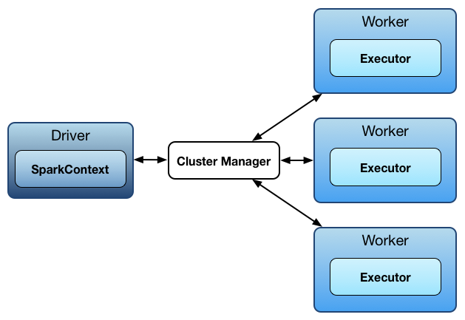

Spark Architecture (continued)
Spark Context:
Spark Context is the driver program that interacts with the cluster manager, and worker nodes execute the tasks.
The SparkContext is a central entry point for Spark functionality. It is responsible for coordinating the execution of tasks across a cluster, managing the distribution of data, and scheduling jobs. The SparkContext is the foundation upon which all other Spark functionality is built, and it is the first thing that needs to be created when starting a Spark application.
img src: https://spark.apache.org/
Notes:
Spark Context is an independent process through which spark application runs over a cluster. It gives the handle to the distributed mechanism/cluster so that you may use the resources of the distributed machines in your job.

Slide 16
Spark Architecture (continued)
In other words, we can say that Spark Context is the main entry point of Spark Core. Spark application programs use a SparkContext object, known as the driver program.
Spark Context allows us to access further functionalities of spark. This helps to establish a connection to the Spark execution environment. It provides access to the Spark cluster, even with a resource manager. SparkContext acts as the master of the Spark application. It offers various functions, such as:
Getting the current status of the Spark application.
Canceling the job.
Canceling the stage.
Running jobs synchronously.
Running jobs asynchronously.
Accessing persistent RDD.
Un-persisting RDD.
Programmable dynamic allocation.

Slide 17
Spark Architecture (continued)
Role of Apache Spark Driver:
The driver acts as the master node that controls the execution of a Spark application. The Spark driver is the central point and entry point of the Spark shell and runs the main function of an application. We can create a SparkContext in Spark Driver.
The driver initializes the SparkContext (or SparkSession in newer versions) to connect with the cluster manager.

Slide 18
Spark Architecture (continued)
Role of Apache Spark Driver:
The Apache Spark Executor acts as a single worker node and plays a very important role in executing several tasks. Every executor has the same fixed heap size and number of cores. The Driver program launches the tasks, which run on individual worker nodes. The tasks operate on a subset of RDDs present on that node. The programs running on the worker nodes are called executors.
Executors actually run for the whole life of a Spark application—referred to as the “Static Allocation of Executors” process.
Users can also select for dynamic allocations of executors. We can also add or remove Spark executors dynamically according to the overall workload.
Executors perform all of the data processing.
Executors write data to external sources and read data from external sources.
We can store computation results in-memory. It is also possible to store data in cache, as well as on hard disks.
Executors interact with the storage systems.
Each application gets its own executor processes, which remain in memory up to the duration of the complete application and runs tasks in multiple threads. This means that each application is independent from the other, on both the scheduling side since each driver schedules its own tasks, and on the executor side, as tasks from different applications run in different JVMs.

Slide 19
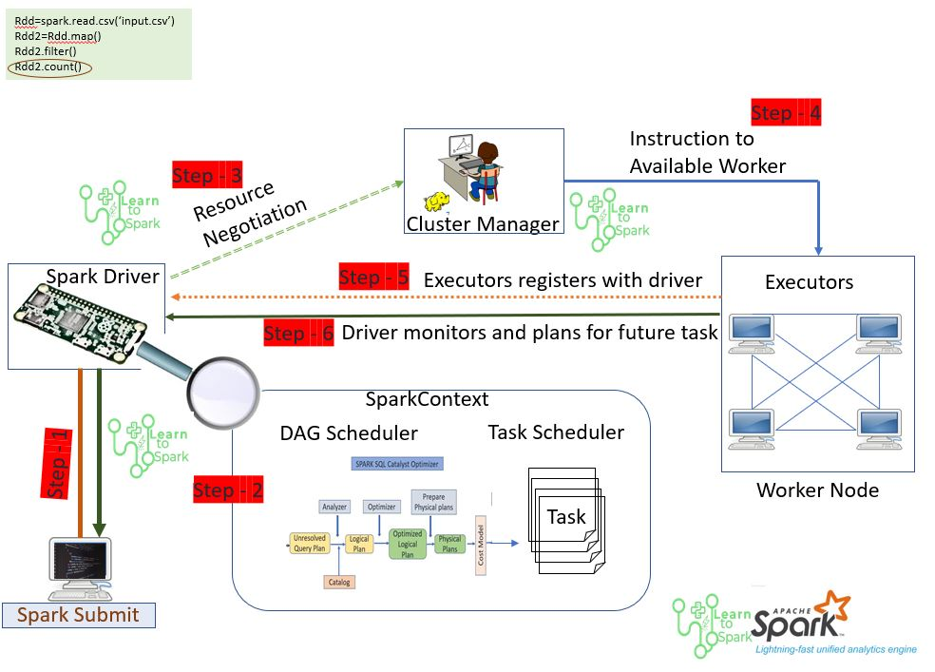
Spark Architecture (continued)
Spark Driver contains the DAG (directed acyclic graph) scheduler, task scheduler, backend scheduler, and block manager components. The driver translates user code into a specified job. After which, we can execute over the cluster.
The driver program schedules the job execution and negotiates with the cluster manager.
The driver program translates the RDDs into the execution graph. It also splits the graph into multiple stages and stores the metadata about all RDDs, as well as their partitions.
The driver program creates tasks by converting applications into small execution units. After the executor executes the task, the worker processes the task, which runs individual tasks.
Source: learntospark.com

Slide 20
Spark Deployment Modes
Mode | Driver | When To Use
Client Mode | The driver runs on the machine from where Spark job is submitted. | When the job submitting machine is very near to the Cluster, there is no network latency. Failure chances are high due to network issues.
Cluster Mode | The driver is launched on any of the machines on the cluster, not on the client machine where the job is submitted. | When the job-submitting machine is far from the cluster, failure chances are less due to network issues.
Standalone Mode | The driver will be launched on the machine where the master script is started. | Useful for development and testing purposes; not recommended for production-grade applications.

Slide 21
Overview of PySpark?
PySpark is the Python API for Apache Spark, allowing developers and data engineers to leverage the power of distributed computing using Python. It enables large-scale data processing, real-time analytics, and machine learning across clusters of computers. Using PySpark, you can also work with RDD (Resilient Distributed Dataset) in the Python programming language using its library name Py4j.
Python-Friendly – Enables Python developers to use Spark without learning Java or Scala.
Reference: https://spark.apache.org/
Notes:
PySpark is a must-learn technology for Data Engineers, Data Scientists, and Big Data professionals looking to work with large-scale data processing!

Slide 22
Key Features of PySpark
Distributed Computing: PySpark distributes data across multiple machines, enabling parallel processing and improving performance.
Scalability: Handles terabytes of data efficiently, making it ideal for Big Data applications.
In-Memory Processing: Unlike traditional Hadoop MapReduce, Spark stores intermediate results in memory, making it 100x faster
Supports Multiple Workloads: Can be used for batch processing, real-time streaming, machine learning, and graph processing.
Seamless Integration with Python Ecosystem: Works with Pandas, NumPy, Scikit-learn, TensorFlow, etc.

Slide 23
How does PySpark work?
Spark Context (SparkContext) – The entry point for PySpark, responsible for managing the connection to a Spark Cluster.
Resilient Distributed Dataset (RDD) – The fundamental data structure of Spark, allowing fault-tolerant, parallel processing.
DataFrames & Spark SQL – Similar to Pandas DataFrames but optimized for distributed computing.
Spark MLlib – A machine learning library that allows scalable ML model training.
Spark Streaming – Enables real-time data processing from sources like Kafka, Flume, and AWS Kinesis.

Slide 24
Downloading SPARK
Download Spark from https://spark.apache.org/downloads.html. This documentation is for Spark version 3.2.1. Spark uses Hadoop’s client libraries for HDFS and YARN.
Downloads are pre-packaged for a handful of popular Hadoop versions. Users can also download a “Hadoop free” binary and run Spark with any Hadoop version from https://spark.apache.org/docs/latest/hadoop-provided.html.
Scala and Java users can include Spark in their projects using its Maven coordinates, and Python users can install Spark from PyPI.
If you want to build Spark from source, visit https://spark.apache.org/docs/latest/building-spark.html.

Slide 25
Install Apache Spark on Windows
This lab guides you through the installation of Apache Spark on a Windows machine; it provides step-by-step instructions on downloading Spark from the official website and installing it. This includes setting environment variables and adding a winutils.exe file. Finally, the lab details how to launch Spark and verify the installation.
Click here for GLAB 345.1.1 - Install Apache Spark on Windows Machine

Slide 26
Additional Information About Spark Setup
If PySpark throws errors, set some environment variables. You can use the below lines of code at the beginning of the main Python script.
import os
import sys
os.environ['PYSPARK_PYTHON'] = sys.executable
os.environ['PYSPARK_DRIVER_PYTHON'] = sys.executable
After that, you can create the spark session
from pyspark.sql import SparkSession
session = SparkSession.builder.getOrCreate()

Slide 27
Spark-Submit Command
Driver Program: A PySpark application runs as a driver program, which consists of the main program and creates a SparkContext to coordinate tasks across the cluster.
Cluster Manager: The Spark driver communicates with a cluster manager (e.g., YARN, Apache Mesos, or Spark's standalone cluster manager) to acquire resources and manage the execution of tasks.
Spark-Submit Command
The `Spark-Submit` command is used to submit a Spark program or PySpark application (or job) to the cluster manager by specifying various options and configurations. The `Spark-Submit` command supports the following:
Submitting a Spark application to different cluster managers, such as YARN, Kubernetes, Mesos, and Standalone.
Submitting a Spark application in either client or cluster deployment mode.
Spark binary comes with a spark-submit.sh script file for Linux, Mac, and spark-submit.cmd command files for windows. These scripts are available at the $SPARK_HOME/bin directory.

Slide 28
Spark-Submit Command (continued)
Spark-Submit Command with the most-used command options:
Using the --deploy-mode option, you can specify where to run the Spark application driver program. Spark supports cluster and client deployment modes.
Using the --master option, you can specify which cluster manager to use for running your application. Spark currently supports YARN, Mesos, Kubernetes, Standalone, and Local modes.
./bin/spark-submit \
--master <master-url> \
--deploy-mode <deploy-mode> \
--conf <key<=<value> \
--driver-memory <value>g \
--executor-memory <value>g \
--executor-cores <number of cores> \
--jars <comma separated dependencies>
--class <main-class> \
<application-jar> \
[application-arguments]
You can also submit an application like the one below (without using the script).
./bin/spark-class org.apache.spark.deploy.SparkSubmit <options & arguments>
For more information about Spark-Submit Command, visit: Submit command
https://sparkbyexamples.com/spark/spark-submit-command/
https://spark.apache.org/docs/latest/submitting-applications.html

Slide 29
Initializing PySpark Application
To use Jupyter Notebook with Spark, we need to do a little more work. There are two ways to use Jupyter with Spark, but the method that is most simple, applicable, and general is the method of installing the findspark package via
pip install findspark. findspark helps Jupyter recognize Spark’s environment.Then on Jupyter, type below command
import findspark
findspark.init()
Afterward, simply import the PySpark libraries as shown below:
import pyspark
from pyspark import SparkContext, SparkConf
That is literally all we need! We can, of course, still use Apache Spark on the terminal simply by typing the `pyspark` command if we want, but it is always good to have more options.

Slide 30
Initializing Spark Application (continued)
How to Create Spark Context:
A SparkContext is created by using the SparkConf configuration object, which can be used to set various configuration options for the Spark application, such as the amount of memory allocated to the application, the number of cores used, and the master URL. For example:
conf = SparkConf().setAppName(app_name).setMaster(master)
sc = SparkContext(conf)
The app_name parameter is a name for your application to show on the cluster UI. Master is a Spark, Mesos or YARN cluster URL, or a special "local" string to run in local mode. In practice, when running on a cluster, you will not want to hardcode master in the program, but rather launch the application with spark-submit and receive it there. However, for local testing and unit tests, you can pass "local" to run Spark in-process.
The below example creates context with a Master as local and an app name as Spark_Example_App.
# Create SparkContext
from pyspark import SparkContext
sc = SparkContext("local", "Spark_Example_App")
print(sc.appName)

Slide 31
Example - Initializing Spark Application
The example below creates context with a master as local and app name as Spark_Example_App.
# Create SparkContext
from pyspark import SparkContext
sc = SparkContext("local", "Spark_Example_App")
print(sc.appName)
You can also create it using SparkContext.getOrCreate(). It actually returns an existing active SparkContext; otherwise, it creates one with a specified master and app name.
# Create Spark Context
from pyspark import SparkConf, SparkContext
conf = SparkConf()
conf.setMaster("local").setAppName("Spark Example App")
sc = SparkContext.getOrCreate(conf)
print(sc.appName)
We used SparkConf, but it is optional. Sometimes, we need to set a few configurations and parameters to run a Spark application on the local or cloud cluster. In other words, SparkConf offers configurations to run a Spark application.

Slide 32
How to Stop `SparkContext`
Use SparkContext.stop() to stop SparkContext. Make sure you stop the context within a final block.
Spark does not support two contexts running concurrently in the same program.

Slide 33
Do We Use SparkSession or SparkContext in PySpark?
In PySpark, you primarily use SparkSession, but it internally manages SparkContext. Here's how they differ:
SparkSession (Recommended for PySpark)
Introduced in Spark 2.0 to unify all Spark functionalities.
Provides access to DataFrames, Datasets, SQL, and Streaming APIs.
Manages SparkContext internally, so you don’t need to initialize SparkContext separately.
Recommended for modern PySpark applications.
SparkContext (Not Recommended) because SparkContext:
Does not support DataFrames, SQL, or Streaming directly.
Still useful for low-level RDD-based operations.
Note: As we are in a learning environment, we will explore both SparkContext and SparkSession in this course

Slide 34
Do We Use SparkSession or SparkContext in PySpark?
Feature | SparkSession (✅ Recommended) | SparkContext (⚠️ Only for RDDs)
Introduced in | Spark 2.0 | Spark 1.x
Supports RDDs | ✅ Yes (via sparkContext) | ✅ Yes
Supports DataFrames | ✅ Yes | ❌ No
Supports SQL | ✅ Yes | ❌ No
Supports Streaming | ✅ Yes | ❌ No
Usage in PySpark | ✅ Primary Entry Point | ⚠️ Only for legacy RDDs

Slide 35
Knowledge Check
What are the benefits of Apache Spark?
What are the components of the Spark Ecosystem?
What is PySpark and what are its key features?
Explain PySpark SparkContext.
Explain PySpark SparkConf.

Slide 36
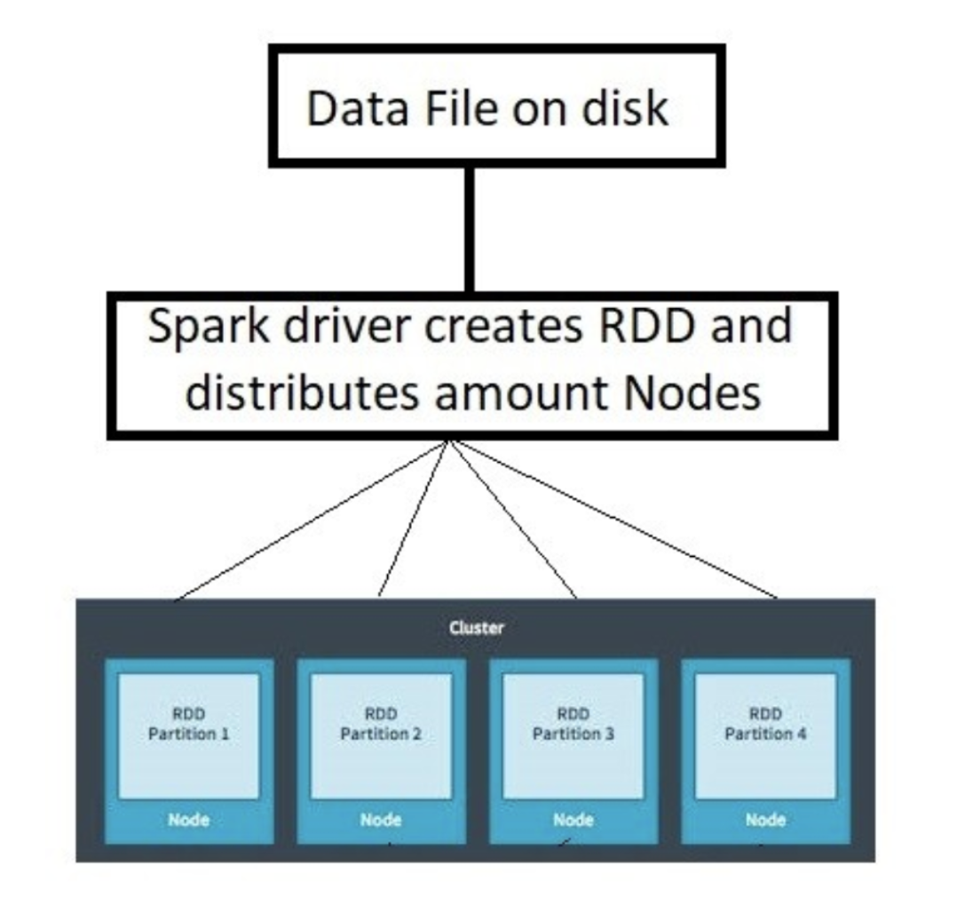
Overview of Spark RDD (1 of 2)
Spark Resilient Distributed Dataset (RDD) is simply a collection of data distributed across the cluster. RDD is the fundamental and backbone data type in PySpark.
Resilient – Means that it is able to withstand all of the losses itself.
Distributed – Indicates that the data is partitioned or is at different locations.
Dataset – Refers to a group of data on which we are performing different operations.
Source: medium.com

Slide 37
Overview of Spark RDD (1 of 2)
RDD is a fundamental building block of PySpark, which is a fault-tolerant, immutable distributed collection of objects. Once you create an RDD, you cannot change it (immutable). Each record in an RDD is divided into logical partitions, which can be computed on different nodes of the cluster.
An RDD is basically a large dataset encapsulated. An RDD is a data structure that can be used to compute results in Spark.
There are two types of operations we can perform on RDDs:
Transformations – Applying a function to each “row” of an RDD returns a new RDD.
Actions – Computing a result based on data in an RDD.
(continue…)

Slide 38
Overview of Spark RDD (3 of 3)
Fault tolerance: An RDD can self-recover from any failure. This improves its fault tolerance. Transforming RDDs creates a coherent execution strategy. An RDD lineage is a logical execution graph plan (DAG). If the machine breaks, we can recover the data by repeating the computation on the RDD lineage node.
Immutable and Read-only: Because RDDs are immutable, they cannot be changed. This attribute ensures consistency in subsequent computations. Once produced, RDDs can only be turned into new RDDs. Its transformation mechanisms enable this.
Spark automatically distributes RDD data across the cluster.

Slide 39
What is a lazy evaluation?
Lazy evaluation in Sparks means the process where all Transformations get executed only after an Action is triggered.
Once Spark sees an ACTION being called, it starts looking at all the Transformations and creates a DAG. DAG Simply a sequence of operations that need to be performed in a process to get the resultant output.

Slide 40
How to Create RDD
There are two ways to create RDDs:
Parallelize an existing collection in your driver program.
Use External Datasets (external storage system), such as a shared file system, HDFS, HBase, or any data source such as JSON, CSV, text files, sequence files, etc.)

Slide 41
Parallelize Collections - RDD
Parallelize() is a function in SparkContext and is used to create an RDD from an existing collection in your driver program. The Parallelize() method is used only for testing but not in real time, as the entire data will reside on one node, which is not ideal for production.
Below is an example of how to create an RDD using a parallelize method from SparkContext.
rdd_data = sc.parallelize([1, 2, 3, 4, 5])
The PySpark shell provides the SparkContext variable “sc”; use sc.parallelize() to create an RDD.
Open the PySpark shell or Jupyter notebook, and write the code below in it.
from pyspark import SparkContext
sc =SparkContext()
data = [1,2,3,4,5,6,7,8,9,10,11,12]
rdds=sc.parallelize(data)
display(rdds, rdds.collect())
collect(): This function is used to retrieve all of the elements of the dataset.

Slide 42
External Data Sets - RDD
To read data from an external source file into a Spark RDD (Resilient Distributed Dataset), you can use the sparkContext.textFile() method provided by the SparkContext object. Here's how you can do it:
Example: rdd_file = sparkContext.textFile("path/folder/data.txt")
Once created, rdd_file can be acted on by dataset operations. For example, we can add up the sizes of all the lines using the map and reduce operations as follows:
rdd_file.map(lambda s: len(s)).reduce(lambda a, b: a + b)

Slide 43
External Data Sets - RDD (continued)
Some notes on reading files with Spark:
If utilizing a local filesystem path, the file must be accessible on worker nodes. Make sure all workers have the file or utilize a network share.
All of Spark’s file-based input methods, including textFile, support running on directories, compressed files, and wildcards as well. For example, you can use textFile("/my/directory"), textFile("/my/directory/*.txt"), and textFile("/my/directory/*.gz").
The textFile() method accepts a second input to regulate the file's partitioning. Spark produces one partition for each block of the file (blocks are 128MB in HDFS by default), but you can request more partitions by supplying a larger value. Partitions must equal blocks.

Slide 44
Example - External Data Sets - RDD
1 - Click here for Download dummy Dataset named “airport.txt.”
2 - Open Notebook and add the lines of code below:
from pyspark import SparkContext
sc = SparkContext.getOrCreate()
# remember: change the path/location of the file
airports = sc.textFile("C:/DataFolder/airports.txt")
airports.take(9)
#.take() : shows content and structure/metadata for a limited number of rows for a very large dataset.
Output
['1,"Goroka","Goroka","Papua New Guinea","GKA","AYGA",-6.081689,145.391881,5282,10,"U","Pacific/Port_Moresby"',
'2,"Madang","Madang","Papua New Guinea","MAG","AYMD",-5.207083,145.7887,20,10,"U","Pacific/Port_Moresby"',
'3,"Mount Hagen","Mount Hagen","Papua New Guinea","HGU","AYMH",-5.826789,144.295861,5388,10,"U","Pacific/Port_Moresby"',
'4,"Nadzab","Nadzab","Papua New Guinea","LAE","AYNZ",-6.569828,146.726242,239,10,"U","Pacific/Port_Moresby"',
'5,"Port Moresby Jacksons Intl","Port Moresby","Papua New Guinea","POM","AYPY",-9.443383,147.22005,146,10,"U","Pacific/Port_Moresby"',
'6,"Wewak Intl","Wewak","Papua New Guinea","WWK","AYWK",-3.583828,143.669186,19,10,"U","Pacific/Port_Moresby"',
'7,"Narsarsuaq","Narssarssuaq","Greenland","UAK","BGBW",61.160517,-45.425978,112,-3,"E","America/Godthab"',
'8,"Nuuk","Godthaab","Greenland","GOH","BGGH",64.190922,-51.678064,283,-3,"E","America/Godthab"',
'9,"Sondre Stromfjord","Sondrestrom","Greenland","SFJ","BGSF",67.016969,-50.689325,165,-3,"E","America/Godthab"']

Slide 45
Passing Functions in Spark
There are three recommended methods for passing functions into Spark:
Lambda expressions (e.g., lambda s: len(s))
Local function definitions within Spark
Top-level functions in a module
Methods #1 and #2 are straightforward. However, when using method #3 (e.g., if you have a class whose function you are calling), you cannot reference the class within the function. Doing so would cause the entire object to be sent to the cluster.
To avoid this, copy the required field into a local variable instead of accessing it externally, and then pass the function.

Slide 46
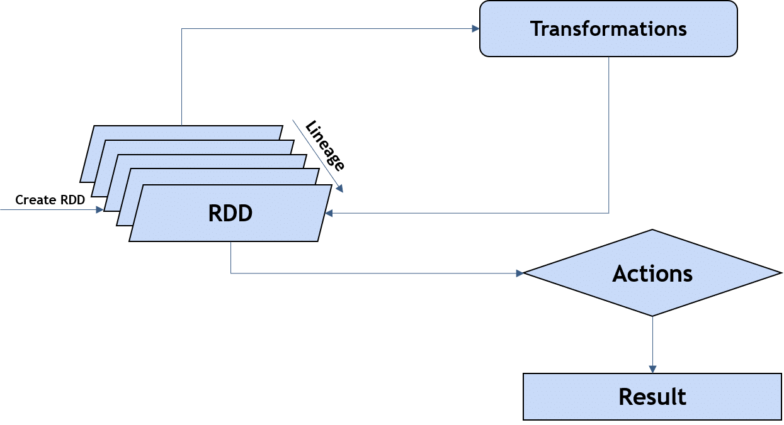
Introduction to RDD Operations
RDD Transformations – Transformations are lazy operations. Apply a function to each “row” of an RDD. Instead of updating an RDD, these operations return another RDD or a new RDD.
RDD Actions – Compute a result based on data in an RDD.
Spark RDD General Workflow
Generate initial RDDs from external data.
Apply transformation.
Launch actions.
Source: intellipaat.com

Slide 47
Overview of RDD Transformations
A transformation is a function that produces a new RDD from the existing RDD. It takes an RDD as an input and produces/returns one or more RDDs as an output. Each time, it creates a new RDD when we apply any transformation.
We use transformations to change the data into a usable form.
Some transformation methods on RDD’s are map(), filter(), flatMap(), union(), intersection(), distinct(), groupByKey(), etc. See the documentation for all transformation methods.
What is a lazy evaluation?
The process where all transformations get executed only after an action is triggered.
Example of using filter transformation to create a new RDD holding just strings that contain the word "New York."

Slide 48
RDD Transformations - filter()
One of the most common transformations is filter(), which returns a new RDD with a subset of the data in the original RDD. It takes in a function and returns an RDD formed by selecting those elements, which pass the function (i.e., returns True for the function).
It can be used to remove some invalid rows to clean up the input RDD or just get a subset of the input RDD based on the filter function.
An example of using a filter transformation to create a new RDD holding just two column strings that contain the word "Putnam County Airport."
from pyspark import SparkContext
sc = SparkContext.getOrCreate ()
airports = sc.textFile("C:/DataFolder/airports.txt")
us_airports = airports.filter (lambda line: "Putnam County Airport" in line.split(",")[1])
filtered = us_airports.collect()
print ("Filter RDD -> %s" % (filtered))
Output
Filter RDD -> ['6891,"Putnam County Airport","Greencastle","United States","4I7",\\N,39.6335556,-86.8138056,842,-5,"U","America/New_York"']
Note: airports.txt is a data set which we downloaded in a previous example.

Slide 49
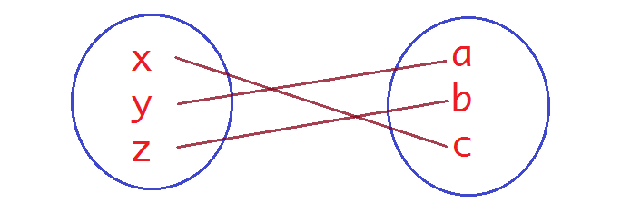
RDD Transformations - map()
A map() transformation applies a function to each element of RDD and returns the result as a new RDD.
Map transforms an RDD of length N into another RDD of length N. The input and output size of the RDDs will be the same. Or to put it in another way, one element in input gets mapped to only one element in output.
In the map, we have the flexibility that the input and the return type of RDD may differ from each other. For example, we can have the input RDD type as String. After applying the map() function, the returned RDD can be Boolean or integer, etc.
Example of using the map() transformation to create a new RDD holding elements that are twice the value of the elements of the input RDD ([1,2,3,4,5] 🡪 [2,4,6,8,10]):
Syntax
RDD.map(<function>)
//where<function> is the transformation function for each of the elements of the source RDD.
Notes:
Takes in a function and passes each element in the input RDD through the function, with the result of the function being the new value of each element in the resulting RDD.
• It can be used to make HTTP requests to each URL in our input RDD, or it can be used to calculate the square root of each number.

Slide 50
Example: Transformations - map()
This below PySpark script demonstrates the process of creating a Resilient Distributed Dataset (RDD) and applying a transformation using the map() function.
from pyspark import SparkContext
sc = SparkContext.getOrCreate ()
data = ["scala","java","hadoop","spark","akka","spark vs hadoop","pyspark","Java"]
rdd=sc.parallelize(data)
rdd2=rdd.map(lambda x: (x,1))
for element in rdd2.collect():
print(element)
('scala', 1)
('java', 1)
('hadoop', 1)
('spark', 1)
('akka', 1)
('spark vs hadoop', 1)
('pyspark', 1)
(Java', 1)
Output

Slide 51
Example: Transformations - map() and filter()
Below is an example of map() and filter. The code below will split the airport names and country names and then filter only those airports that are in the United States. In this example, we are using airport.txt
from pyspark import SparkContext
sc = SparkContext.getOrCreate ()
# Do not forget to change the path of the file
airportsRDD = sc.textFile("C:/DataFolder/airports.txt")
# Split columns for Airport names and country
airportPairRDD = airportsRDD.map(lambda line: (line.split(",")[1], line.split(",")[3]))
# printing list of all airport and country names
for element in airportPairRDD.collect():
print(element)
# filter list of all United States airports
airportsInUSA = airportPairRDD.filter(lambda keyValue: keyValue[1] == "\"United States\"")
print("------ list of USA Airports -------------")
for elements in airportsInUSA.collect():
print(elements)

Slide 52
Transformations - flatmap()
A flatMap() is a transformation operation that applies to each element of an RDD, and it returns the result as a new RDD. It is similar to map(), but flatMap() allows for returning 0, 1, or more elements from the function. In the flatMap operation, a developer can define a custom business logic. The same logic will be applied to all the elements of the RDD.
Example: A flatMap() transforms an RDD of length N into another RDD of length M. Therefore, the answer will be N < M and N = M.
Example of using flatMap transformation to create a new RDD consisting of every word from the file:
from pyspark import SparkContext
sc = SparkContext.getOrCreate ()
# Do not forget to change the path of the file
airportsRDD = sc.textFile("C:/DataFolder/airports.txt")
airportPairRDD = airportsRDD.map(lambda line: (line.split(",")[1], line.split(",")[3]))
words=airportsRDD.flatMap(lambda x: x.split(" "))
for ele in words.collect():
print(ele)

Slide 53
Example - flatmap()
The flatMap() is just the same as the map(); it is used to return a new RDD by applying a function to each element of the RDD, but the output is flattened. In this function, we can return multiple lists of elements. Let us look at the example to understand the difference in detail:
from pyspark import SparkContext
sc = SparkContext.getOrCreate ()
R = sc.parallelize([3, 4, 5])
output = R.map(lambda x: range(1, x)).collect()
print("Output : ",output)
S = sc.parallelize([3, 4, 5])
output1 = S.flatMap(lambda x: range(1, x)).collect()
print("Output : ",output1)
output
Output : [range(1, 3), range(1, 4), range(1, 5)]
Output : [1, 2, 1, 2, 3, 1, 2, 3, 4]

Slide 54
Transformations – SET Operations
Set operations, which are performed on one RDD:
sample
distinct
Set operations, which are performed on two RDDs, and produce one resulting RDD:
union
intersection
subtract
cartesian

Slide 55
Transformations - sample()
The sample operation will create a random sample from an RDD and is useful for testing purposes.
It returns an RDD containing a sample of the previous RDD. It takes in a boolean and a float.
A boolean is whether or not a sample should be done with replacement (True indicates "with replacement").
A float is the size of the sample to be taken:
0.1 = 10%
0.0592 = 5.92%
Example: Using a sample transformation to create a new RDD consisting of 5 percent sample of the original RDD with replacement:
from pyspark import SparkContext
sc = SparkContext.getOrCreate ()
airportsRDD = sc.textFile("C:/Users/Downloads/adult_data.csv")
print(airportsRDD.sample(True,0.05).collect())

Slide 56
Transformations - distinct()
The distinct() operation returns an RDD containing only the distinct elements of the original RDD.
It should be used after most filtering is done, as it requires a lot of resources.
Example: Using the distinct() transformation to create a new RDD consisting of only distinct words from the original RDD:
from pyspark import SparkContext
sc = SparkContext.getOrCreate ()
dataRDD = sc.textFile("C:/Users/word_count.txt")
words=dataRDD.flatMap(lambda x: x.split(" "))
print(words.distinct().collect())

Slide 57
Transformations - union()
The union() operation returns an RDD containing all data from two RDDs.
It takes in a second RDD as a parameter. It can contain duplicates.
Example: Using the union() transformation to create a new RDD consisting of data from both RDDs:
rdd1 = sc.parallelize([1, 2, 3])
rdd2 = sc.parallelize([4, 5, 6])
rdd3 = sc.parallelize([7, 8, 9])
rdd = sc.union([rdd1, rdd2, rdd3])
rdd.collect()

Slide 58
Transformations - intersection()
The intersection operation returns an RDD containing only the data contained in both of two RDDs.
Think of intersection like an INNER JOIN.
It takes in a second RDD as a parameter.
It removes all duplicates from given RDDs.
ds_one = sc.parallelize([("Mark", 1984), ("Lisa", 1985)])
ds_two = sc.parallelize([("Mark", 1984), ("Anastasia", 2017)])
sorted(ds_one.intersection(ds_two).collect())
Output
[('Mark', 1984)]

Slide 59
Example: intersection()
In this example, the PySpark script reads data from two text files, processes them using RDD transformations, and finds the common elements (the first column) between them.
from pyspark import SparkContext
sc = SparkContext.getOrCreate ()
cardataOne = sc.textFile( "C:/Users/cardataOne.txt").map(lambda d: d.split("\t")[0])
cardataTwo = sc.textFile( "C:/Users/cardataTwo.txt").map(lambda d: d.split("\t")[0])
print(cardataOne.intersection(cardataTwo).collect())
Output
['AMC Matador', 'Ford Maverick', 'AMC Hornet', 'Chevrolet Nova', 'Chevrolet Chevette', 'Chevrolet Woody', 'Volkswagen Rabbit', 'Ford Gran Torino', 'Plymouth Valiant']

Slide 60
Transformations - subtract()
The subtract() operation returns an RDD containing data only present in the first of two RDDs.
Example of using a subtract transformation to create a new RDD consisting of first column strings that are only contained in the first RDD:
cardataOne = sc.textFile( "C:/Users/cardataOne.txt").map(lambda d: d.split("\t")[0])
cardataTwo = sc.textFile( "C:/Users/cardataTwo.txt").map(lambda d: d.split("\t")[0])
print(cardataOne.subtract(cardataTwo).collect())

Slide 61
Challenge Exercise One
Download this dataset about cars:
Create an RDD using this dataset. (Make sure to exclude the first rows as a header.)
Create three sample RDDs from the RDD without replacement.
Two 10 percent samples.
One 20 percent sample.
Create an RDD containing distinct elements from two 10 percent sample RDDs.
Create an RDD containing distinct elements from the 20 percent sample RDDs.

Slide 62
Overview of RDD Actions
Actions return final results of RDD computations. Actions trigger execution using lineage graphs to load the data into the original RDD, carry out all intermediate transformations, and return final results to the driver program or write them out to the file system.
If we define an RDD, data does not get loaded immediately. In addition, none of the transformations actually get computed until you call an action like collect or count. Actions force all transformations to be evaluated.
Some common actions are collect(), count(), take(), top(), countByValue(), reduce(), and foreach(), etc. See the Documentation for all Action methods
Example: Using the count action to get the number of words:
from pyspark import SparkContext
sc = SparkContext . getOrCreate ()
dataRDD = sc.textFile("C:/Users/word_count.txt")
words=dataRDD.flatMap(lambda x: x.split(" "))
print(words.count())

Slide 63
Actions - collect()
The collect operation returns a list containing all of the elements of the RDD. It fetches the entire RDD to a single machine; therefore, the data must be small enough to fit in memory (RAM) on your machine.
It is useful when:
Spark has filtered the RDD to a very small size.
You want to deal with data locally.
Performing a unit test to compare the contents of an RDD to expected values.
Example: Using the collect action to get a list consisting of all the elements of the RDD:
from pyspark import SparkContext
sc = SparkContext.getOrCreate ()
dataRDD = sc.textFile("C:/Users/word_count.txt")
words=dataRDD.map(lambda x: x.split(" "))
print(words.collect())

Slide 64
Actions - count(), countByValue()
The count operation returns an integer, which is the count of the elements (rows).
It is relatively quick and has low memory usage.
The countByValue operation returns a map of unique values to how many times that value occurs.
It is useful when:
The RDD has duplicate rows (especially as a result of using flatMap()).
You want to count how many times duplicates appear.
Getting the most common words from a series of texts.
Example: Using the count and countByValue actions to get the total word count and unique word counts:
from pyspark import SparkContext
sc = SparkContext.getOrCreate ()
lines = sc.textFile("C:/Users/word_count.txt")
words = lines.flatMap(lambda l:l.split())
total_count = words.count()
print(total_count)
unique_word_counts = words.countByValue()
print(unique_word_counts)

Slide 65
Actions - take()
The take() operation returns a list containing N elements of the RDD.
It takes in an integer, N, to specify how many elements.
The elements in the returned list may not be in the expected order and may be biased due to factors such as connectivity.
It is useful for using data locally without worrying about memory usage.

Slide 66
Actions - reduce()
The reduce() operation returns one element from two elements from the RDD by applying the lambda function:
Syntax: RDD.reduce(<function>)
It takes in a function:
Aggregation function. You can define the aggregation function by passing it as an argument or using the lambda function.
Uses two elements from the RDD.
Returns a single new element based on the operations used.
Will be applied until only one element remains.
It is generally used to perform aggregations.
sampledata = sc.parallelize([14,21,88,99,455]);
#aggregate numbers using addition operator
sum = sampledata.reduce(lambda a,b: a+b);
print("Sum of numbers is : ", sum);

Slide 67
Example: Actions - reduce()
Example: Using the reduce action to get the document text length from the RDD:
lines = sc.textFile("C:/Users/word_count.txt")
wordlength = lines.map(lambda l: len (l))
doclength = wordlength.reduce (lambda a,b: a+b)
print(doclength)

Slide 68
Actions - join()
The join() action returns RDD with a pair of elements with the matching keys and all the values for that particular key. In the following example, there are two pairs of elements in two different RDDs. After joining these two RDDs, we get an RDD with elements having matching keys and their values.
from pyspark import SparkContext
x = sc.parallelize([("spark", 1), ("python", 4)])
y = sc.parallelize([("spark", 2), ("python", 5)])
joined = x.join(y)
final = joined.collect()
print ("Join RDD -> %s" % (final))
Output
Join RDD -> [('python', (4, 5)), ('spark', (1, 2))]

Slide 69
Hands-On Exercise
We will use the same dataset from the previous exercises (Dataset about cars).
Create an RDD using this dataset. (Make sure to exclude the first two rows.)
Calculate the following about the cars:
Total Weight.
Average MPG.
How many cars do we have for each origin?
Hint: use zipWithIndex()

Slide 70
Knowledge Check
What is Apache Spark?
Explain the common workflow of a Spark program.
What are the main functions of Spark Core?
What is Spark Driver?
What are the key advantages of PySpark RDD?
Define actions in Spark.

Slide 71
Summary
In this presentation, we explored the various aspects of Apache Spark, including what it is, how to set it up, and what we can do with it via the RDD.
Apache Spark is a multi-language engine for executing data engineering, data science, and machine learning tasks.
PySpark is the Python API for Apache Spark, enabling Python developers to work with Spark's distributed computing capabilities.
Spark's core abstraction is a Resilient Distributed Dataset (RDD), which represents a fault-tolerant, immutable collection of elements distributed across a cluster.
The Spark driver translates user code into jobs and schedules tasks, while executors on worker nodes carry out the data processing.
RDDs can be created by parallelizing existing collections or from external datasets, and they support two types of operations: Transformations and Actions.

Slide 72
References
https://www.learntospark.com/2020/02/spark-architecture.html
https://tropars.github.io/downloads/lectures/LSDM/LSDM-3-spark.pdf
https://gktcs.com/media/PPT/Sanket%20Lolge/PySpark/4-_Action_and_RDD_Transformations.pdf
Apache Spark: Core Concepts, Architecture, and Internals
Apache Spark Documentation

Slide 73
THANK YOU

